Slide 1
Classification : Decision Tree
Decision Trees are a popular supervised machine learning algorithm used for both classification and regression tasks. They work by learning simple decision rules inferred from the data features to predict a target label.
A Decision Tree is structured as a tree where each node represents a decision based on a feature of the data, and each branch represents an outcome of that decision.
The root node is the topmost node, representing the first decision.
The internal nodes are decision points, splitting based on feature values.
Leaf nodes are the endpoints representing the final prediction or output.

Slide 2
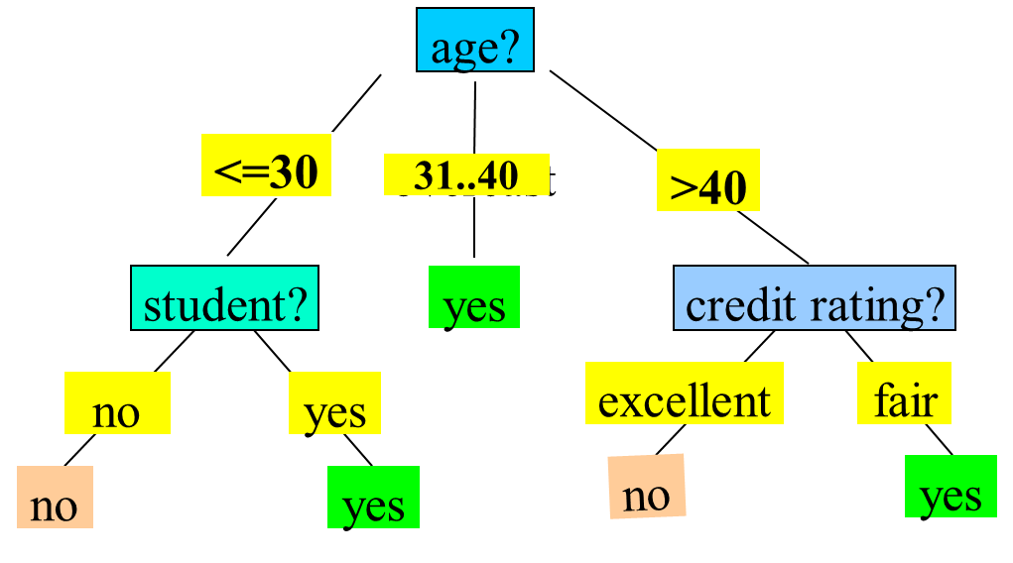
Classification : Decision Tree

Slide 3
Classification : Decision Tree
Basic algorithm (a greedy algorithm):
Tree is constructed in a top-down recursive divide-and-conquer manner
At start, all the training examples are at the root
Attributes are categorical (if continuous-valued, they are discretized in advance)
Examples are partitioned recursively based on selected attributes
Test attributes are selected based on a heuristic or statistical measure (e.g., information gain)

Slide 4
Classification : Decision Tree
ID3 (Iterative Dichotomiser 3) is a classic algorithm used to construct a Decision Tree, primarily for classification tasks. It was developed by Ross Quinlan and serves as one of the earliest algorithms in Decision Tree-based models.
ID3 aims to create a Decision Tree by selecting the most significant feature at each step that best separates the data for classification.
It does this by using information gain (based on entropy) as the criterion to determine the best feature to split on.
Conditions for stopping partitioning:
All records have the same target class (pure leaf node).
No more features to split on (terminate as a leaf node).
Reaching a specified maximum depth or minimum samples threshold to prevent overfitting.

Slide 5
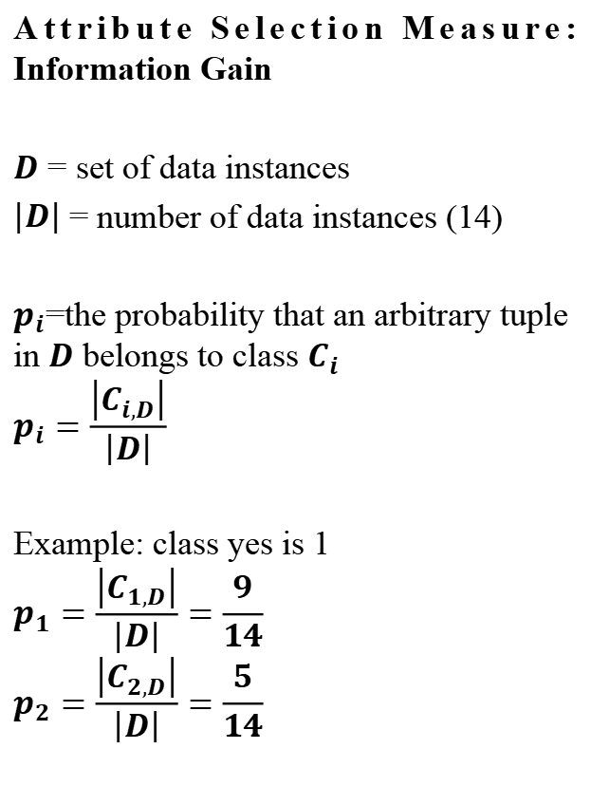
Classification : Decision Tree
Attribute Selection Measure: Information Gain
$D$ = set of data instances
$\left|D\right|$ = number of data instances (14)
$p_{i}$=the probability that an arbitrary tuple in $D$ belongs to class $C_{i}$
$$p_{i}=\frac{\left|C_{i,D}\right|}{\left|D\right|}$$
Example: class yes is 1
$$p_{1}=\frac{\left|C_{1,D}\right|}{\left|D\right|}=\frac{9}{14}$$
$$p_{2}=\frac{\left|C_{2,D}\right|}{\left|D\right|}=\frac{5}{14}$$

Slide 6
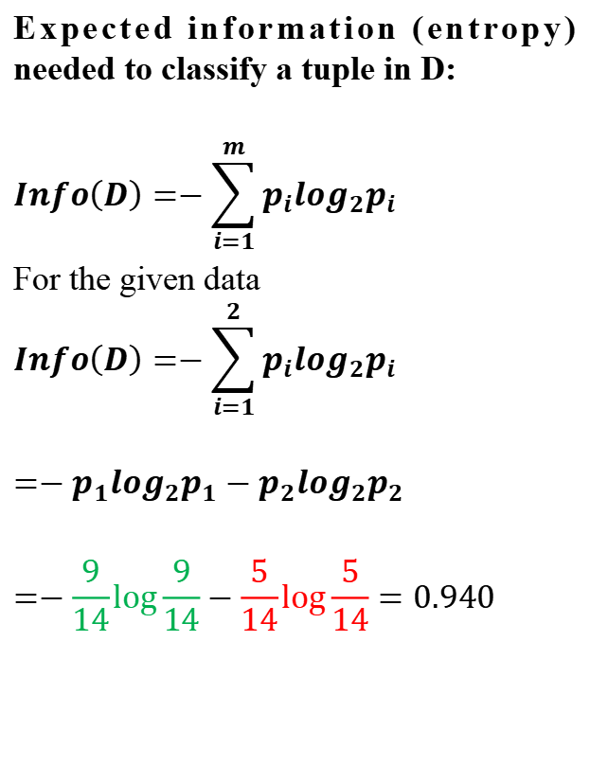
Classification : Decision Tree
Expected information (entropy) needed to classify a tuple in D:
$$Info\left(D\right)=−\sum_{i=1}^{m}{p_{i}\log_{2}p_{i}}$$
For the given data
$$Info\left(D\right)=−\sum_{i=1}^{2}{p_{i}\log_{2}p_{i}}$$
$${=−p}_{1}\log_{2}p_{1}−p_{2}\log_{2}p_{2}$$
$$=−\frac{9}{14}\log{\frac{9}{14}}−\frac{5}{14}\log{\frac{5}{14}}=0.940$$

Slide 7
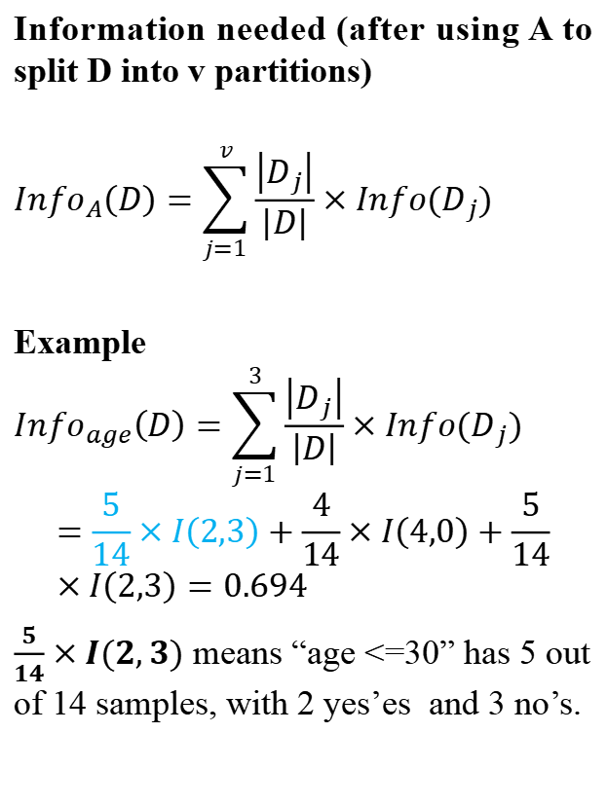
Classification : Decision Tree
Information needed (after using A to split D into v partitions)
$${Info}_{A}\left(D\right)=\sum_{j=1}^{v}{\frac{\left|D_{j}\right|}{\left|D\right|}}×Info(D_{j})$$
Example
$${Info}_{age}\left(D\right)=\sum_{j=1}^{3}{\frac{\left|D_{j}\right|}{\left|D\right|}}×Info(D_{j})$$
$$=\frac{5}{14}×I\left(2,3\right)+\frac{4}{14}×I\left(4,0\right)+\frac{5}{14}×I\left(2,3\right)=0.694$$
$\frac{5}{14}×I(2,3)$ means “age <=30” has 5 out of 14 samples, with 2 yes’es and 3 no’s.

Slide 8
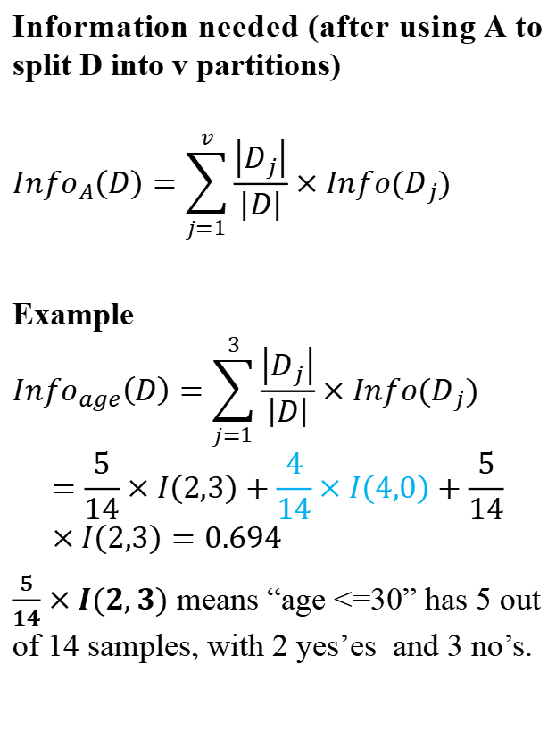
Classification : Decision Tree
Information needed (after using A to split D into v partitions)
$${Info}_{A}\left(D\right)=\sum_{j=1}^{v}{\frac{\left|D_{j}\right|}{\left|D\right|}}×Info(D_{j})$$
Example
$${Info}_{age}\left(D\right)=\sum_{j=1}^{3}{\frac{\left|D_{j}\right|}{\left|D\right|}}×Info(D_{j})$$
$$=\frac{5}{14}×I\left(2,3\right)+\frac{4}{14}×I\left(4,0\right)+\frac{5}{14}×I\left(2,3\right)=0.694$$
$\frac{5}{14}×I(2,3)$ means “age <=30” has 5 out of 14 samples, with 2 yes’es and 3 no’s.

Slide 9
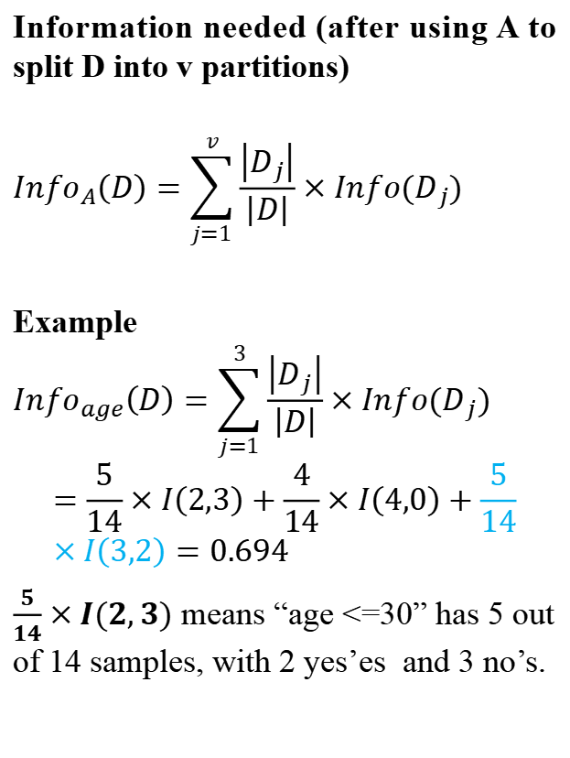
Classification : Decision Tree
Information needed (after using A to split D into v partitions)
$${Info}_{A}\left(D\right)=\sum_{j=1}^{v}{\frac{\left|D_{j}\right|}{\left|D\right|}}×Info(D_{j})$$
Example
$${Info}_{age}\left(D\right)=\sum_{j=1}^{3}{\frac{\left|D_{j}\right|}{\left|D\right|}}×Info(D_{j})$$
$$=\frac{5}{14}×I\left(2,3\right)+\frac{4}{14}×I\left(4,0\right)+\frac{5}{14}×I\left(3,2\right)=0.694$$
$\frac{5}{14}×I(2,3)$ means “age <=30” has 5 out of 14 samples, with 2 yes’es and 3 no’s.

Slide 10
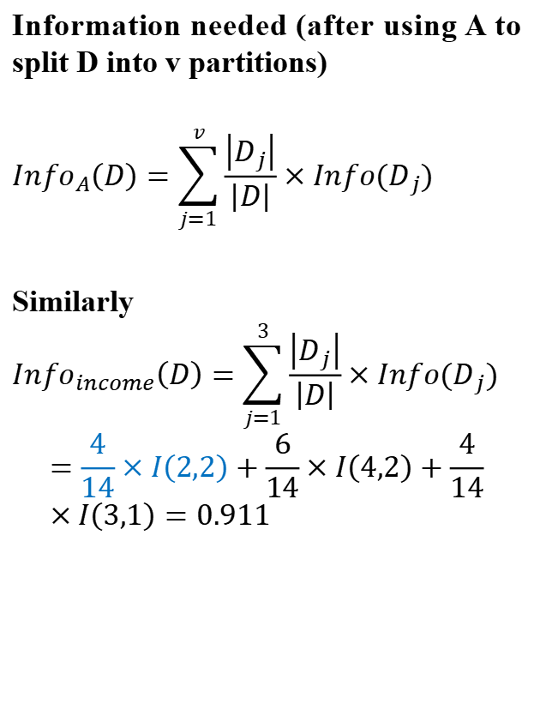
Classification : Decision Tree
Information needed (after using A to split D into v partitions)
$${Info}_{A}\left(D\right)=\sum_{j=1}^{v}{\frac{\left|D_{j}\right|}{\left|D\right|}}×Info(D_{j})$$
Similarly
$${Info}_{income}\left(D\right)=\sum_{j=1}^{3}{\frac{\left|D_{j}\right|}{\left|D\right|}}×Info(D_{j})$$
$$=\frac{4}{14}×I\left(2,2\right)+\frac{6}{14}×I\left(4,2\right)+\frac{4}{14}×I\left(3,1\right)=0.911$$

Slide 11
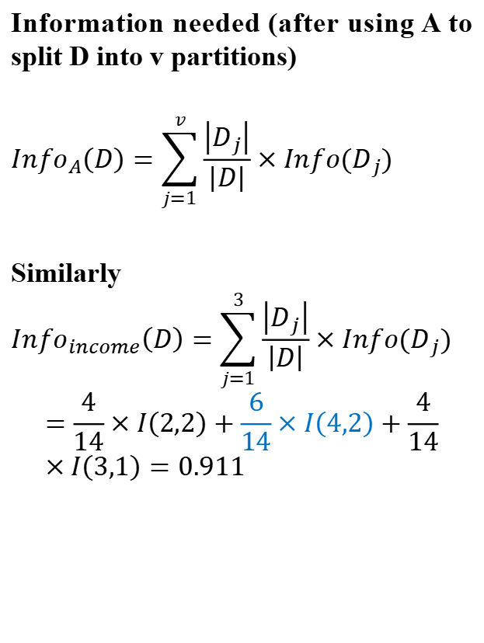
Classification : Decision Tree
Information needed (after using A to split D into v partitions)
$${Info}_{A}\left(D\right)=\sum_{j=1}^{v}{\frac{\left|D_{j}\right|}{\left|D\right|}}×Info(D_{j})$$
Similarly
$${Info}_{income}\left(D\right)=\sum_{j=1}^{3}{\frac{\left|D_{j}\right|}{\left|D\right|}}×Info(D_{j})$$
$$=\frac{4}{14}×I\left(2,2\right)+\frac{6}{14}×I\left(4,2\right)+\frac{4}{14}×I\left(3,1\right)=0.911$$

Slide 12
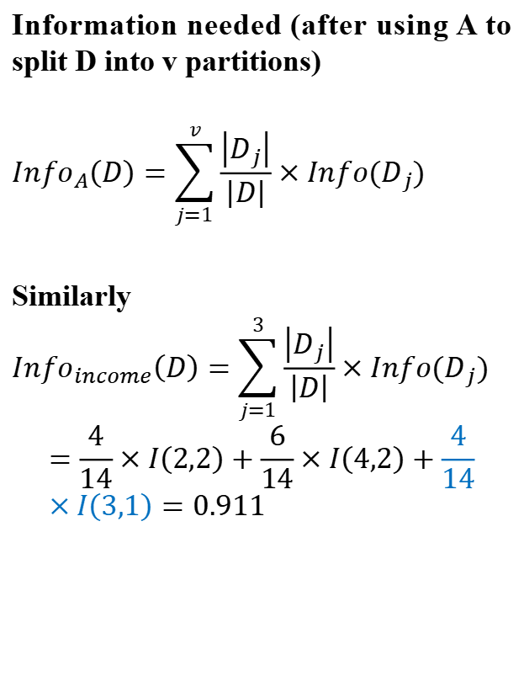
Classification : Decision Tree
Information needed (after using A to split D into v partitions)
$${Info}_{A}\left(D\right)=\sum_{j=1}^{v}{\frac{\left|D_{j}\right|}{\left|D\right|}}×Info(D_{j})$$
Similarly
$${Info}_{income}\left(D\right)=\sum_{j=1}^{3}{\frac{\left|D_{j}\right|}{\left|D\right|}}×Info(D_{j})$$
$$=\frac{4}{14}×I\left(2,2\right)+\frac{6}{14}×I\left(4,2\right)+\frac{4}{14}×I\left(3,1\right)=0.911$$

Slide 13
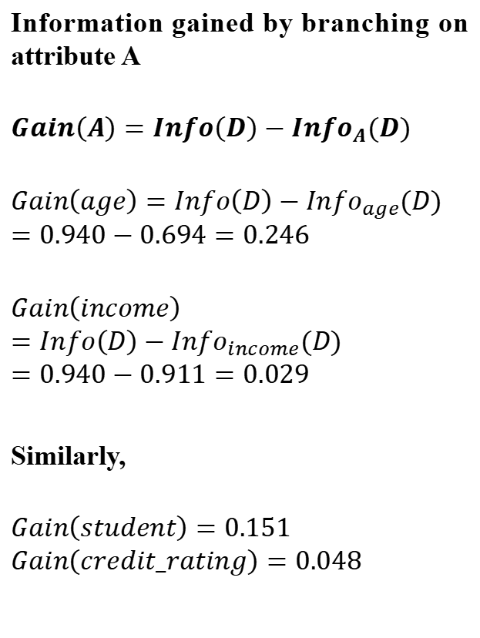
Classification : Decision Tree
Information gained by branching on attribute A
$$Gain\left(A\right)=Info\left(D\right)−{Info}_{A}(D)$$
$$Gain\left(age\right)=Info\left(D\right)−{Info}_{age}(D)$$
$$=0.940−0.694=0.246$$
$$Gain\left(income\right)=Info\left(D\right)−{Info}_{income}(D)$$
$$=0.940−0.911=0.029$$
Similarly,
$$Gain\left(student\right)=0.151$$
$$Gain\left(credit_rating\right)=0.048$$

Slide 14
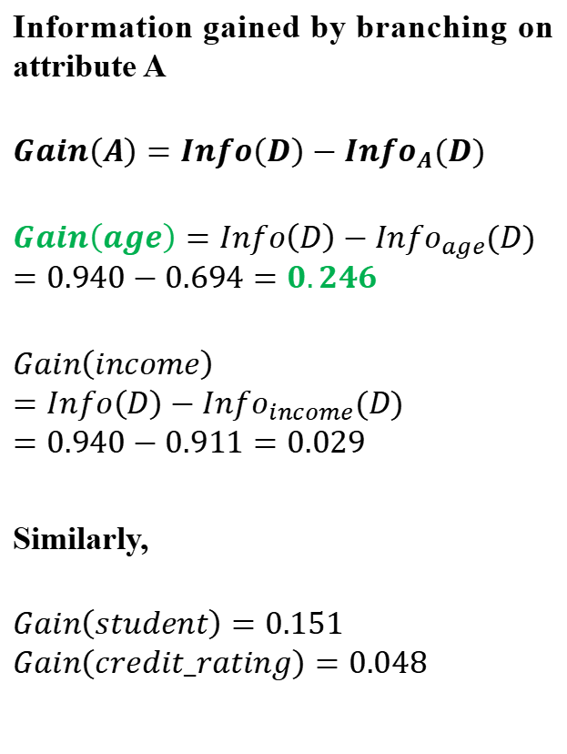
Classification : Decision Tree
Information gained by branching on attribute A
$$Gain\left(A\right)=Info\left(D\right)−{Info}_{A}(D)$$
$$Gain\left(age\right)=Info\left(D\right)−{Info}_{age}(D)$$
$$=0.940−0.694=0.246$$
$$Gain\left(income\right)=Info\left(D\right)−{Info}_{income}(D)$$
$$=0.940−0.911=0.029$$
Similarly,
$$Gain\left(student\right)=0.151$$
$$Gain\left(credit_rating\right)=0.048$$

Slide 15
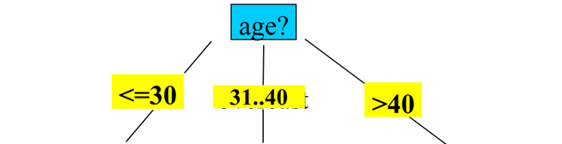
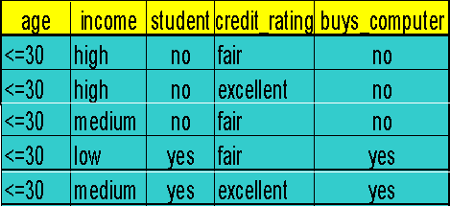
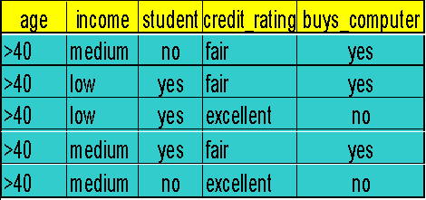
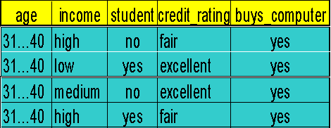
Classification : Decision Tree
Next, repeat the same process with the other nodes with smaller dataset.
So, the first split is on the age attribute

Slide 16
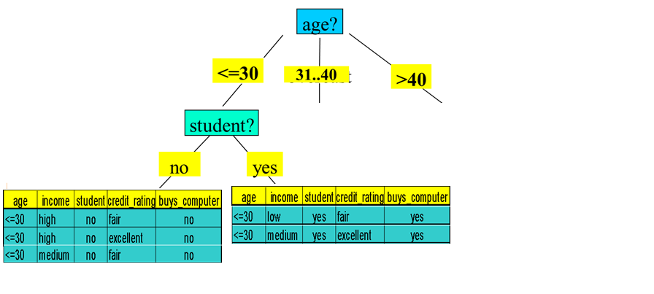
Classification : Decision Tree
Next split is on student at node <=30
All are yes
So, no further split here
All are no
So, no further split here

Slide 17
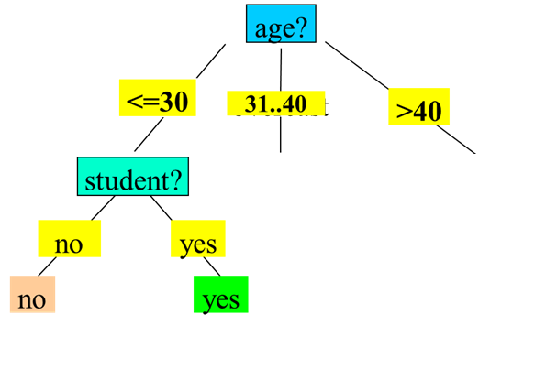
Classification : Decision Tree
No split is required at node 31..40
All are yes
So, no further split here

Slide 18
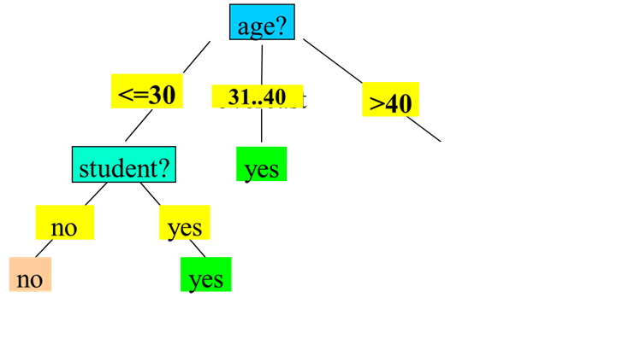
Classification : Decision Tree

Slide 19
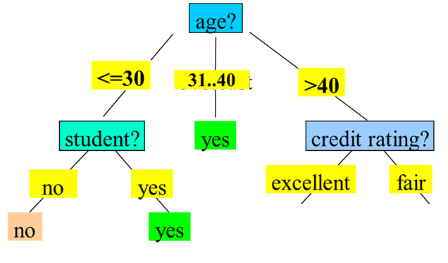

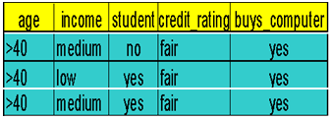
Classification : Decision Tree
Next split is on credit_rating at node >40

Slide 20
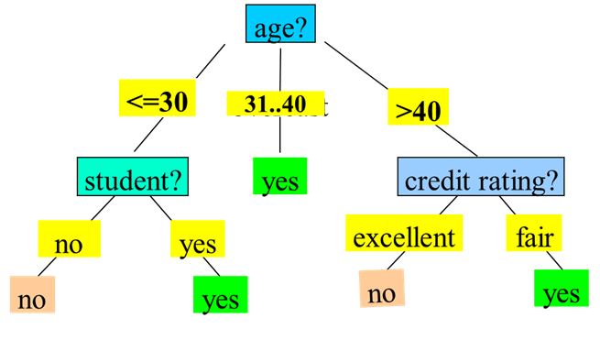
Classification : Decision Tree

Slide 21
Classification : Decision Tree
Classify a new instance
(age: <=30, income: low, student: yes, credit_rating: fair) = buys_computer?

Slide 22
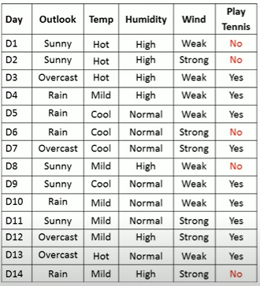
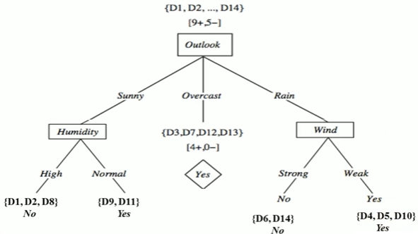
Classification : Decision Tree
Exercise

Slide 23
Classification : Decision Tree
https://colab.research.google.com/drive/1YsHFA55DZ5iQBNq7S11qoS-_WVYtxUYH?usp=sharing

Slide 24
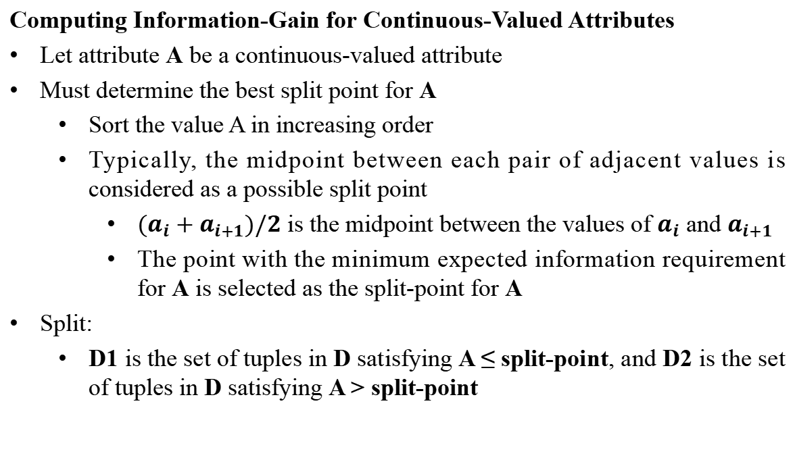
Classification : Decision Tree
Computing Information-Gain for Continuous-Valued Attributes
Let attribute A be a continuous-valued attribute
Must determine the best split point for A
Sort the value A in increasing order
Typically, the midpoint between each pair of adjacent values is considered as a possible split point
${(a}_{i}+a_{i+1})/2$ is the midpoint between the values of $a_{i}$ and $a_{i+1}$
The point with the minimum expected information requirement for A is selected as the split-point for A
Split:
D1 is the set of tuples in D satisfying A ≤ split-point, and D2 is the set of tuples in D satisfying A > split-point

Slide 25
Classification : Decision Tree
Gain Ratio for Attribute Selection (C4.5)
Information gain measure is biased towards attributes with many values
C4.5 (a successor of ID3) uses gain ratio to overcome the problem (normalization to information gain)
GainRatio(A) = Gain(A)/SplitInfo(A)
gain_ratio(income) = 0.029/1.557 = 0.019

Slide 26
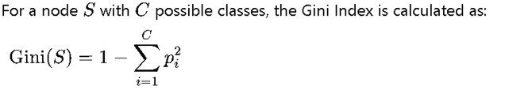
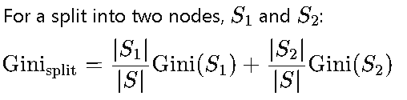
Classification : Decision Tree
Gini Index (CART-Classification and Regression Trees)
Information Gain and Gain Ratio can sometimes exhibit a bias toward features with many unique values. For example, if a feature has many unique categories, Information Gain might prefer it because it creates more distinct subsets.
To address this, Gain Ratio (an adaptation of Information Gain) is used in algorithms like C4.5 to counter this bias, but this additional step adds complexity.
Gini Index, on the other hand, is less sensitive to the number of categories in a feature, reducing the need for an additional adjustment like Gain Ratio.

Slide 27
Classification : Decision Tree
Overfitting in Decision Trees
Overfitting happens when a Decision Tree model becomes too complex, fitting too closely to the noise and specific details of the training data, resulting in poor generalization to new data.
Signs of Overfitting: A decision tree that overfits will often have a high accuracy on the training set but performs poorly on the test set.
Causes of Overfitting:
Allowing the tree to grow too deep, with many nodes and branches.
Having very specific branches (splits) that capture the peculiarities of the training data rather than general patterns.
Consequences: Overfitting leads to a lack of model generalization, where the model captures random fluctuations instead of meaningful trends.

Slide 28
Classification : Decision Tree
Pre-Pruning (Early Stopping):
This approach stops the tree from growing once it meets certain conditions, such as reaching a maximum depth, minimum number of samples per leaf, or minimum information gain threshold. This prevents the tree from developing complex branches that might lead to
Post-Pruning (Cost Complexity Pruning):
This technique first grows the tree to its full depth, then prunes back branches that provide minimal value. Post-pruning can be based on measures like cross-validation to determine the optimal structure that minimizes errors on new data.

